Slide 1
MRA Project Week-1 Great Learning
Amit Jain
30-Oct-2022

Slide 2
Agenda
Introduction
Problem Statement
Exploratory data analysis
Data Descriptive analysis
Univariate Analysis
Bi-Variate Analysis
Multivariate Analysis
Time series Analysis
RFM Analysis
What is RFM
KNIME Tool information
Workflow Nodes used and Logic
Customer Segmentations using RFM Analysis
Who is best customer
Going to be Churn Customers
Lost Customers
Loyal Customers
Recommendations
Summary

Slide 3
Introduction
An automobile parts manufacturing company has collected data of transactions for 3 years. They do not have any in-house data science team .
We need to use data science techniques to provide them with suitable insights about their data and their customers.
Customers also wants to do RFM analysis for their customers and create customer segments based on RFM analysis. So that they can understand their customer in better way and take decisions for them and use Targeted campaigns.
Company has given us a data set for customer’s previous purchase history. It has data elements of 2747 records.

Slide 4
Problem Statement
Automobile manufacturing company have good information about their customer’s purchase history, but they do not have information about how they can bundle their customers. Company looking for these some of the information's from Data science analysis:
They want a customer segmentation
Which Customers are likely to churn
who are their best customers
who are Loyal customers,
what is customers monitory values

Slide 5
Total No of records in sample data set: 2747 Total no of NULL values in sample data set: 0 Duplicate records in data set: 0 Data Dictionary: Data has 20 fields/columns: ORDERNUMBER : Order Number QUANTITYORDERED : Quantity ordered PRICEEACH : Price of Each item ORDERLINENUMBER : order line SALES : Sales amount ORDERDATE : Order Date DAYS_SINCE_LASTORDER : Days_ Since_Lastorder STATUS : Status of order like Shipped or not PRODUCTLINE : Product line – CATEGORY MSRP : Manufacturer's Suggested Retail Price PRODUCTCODE : Code of Product CUSTOMERNAME : customer PHONE : Phone of the customer ADDRESSLINE1 : Address of customer CITY : City of customer POSTALCODE : Postal Code of customer COUNTRY : Country customer CONTACTLASTNAME : Contact person customer CONTACTFIRSTNAME : Contact person customer DEALSIZE : Size of the deal based on Quantity and Item Price
Exploratory data analysis
Data Descriptive analysis

Slide 6
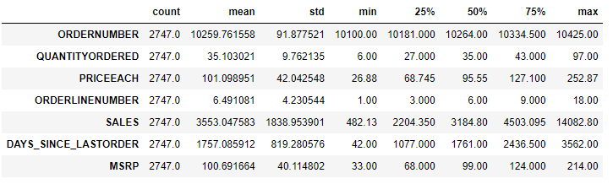
Data Description Insights: 1. Quantity Ordered : with Minimum of 6 and Max of 97 Quantities ordered, fields looks good and no unexpected data from description 2. Sales : Minimum sales of Rs 482.13 and maximum sales of Rs 14082.80 with Std dvt of 4503, with mean Sales of 35530.47 Rs 3. MSRP Min value is 33 and maximum amount of the product as 214, Mean MSRP is 100.69
Exploratory data analysis
Data Descriptive analysis

Slide 7
We have taken categorical columns of Sample data and checked, how many categories we have in each column. Important Categorical columns are as follows: 1. STATUS : Count for this categories are 6. Following are the distribution counts for this columns: Disputed 14, In Process 41, On Hold 44, Resolved 47,Cancelled 60, Shipped 2541 2. PRODUCTLINE : and Count for this categories are 7. Trains 77, Ships 230, Trucks and Buses 295, Planes 304, Motorcycles 313, Vintage Cars 579, Classic Cars 949 3. COUNTRY : and Count for this categories are 19 Ireland 16,Philippines 26,Switzerland 31,Belgium 33,Japan 52,Austria 55,Sweden 57,Germany 62,Denmark 63,Canada 70,Singapore 79,Norway 85,Finland 92,Italy 113,UK 144,Australia 185,France 314,Spain 342,USA 928 Looks like most of the customer belongs to USA with 928 numbers, followed by Spain, with 342, whereas least no of customer belongs to Ireland Country with only 16 numbers 4. Field name is DEALSIZE : and Count for this categories are 3 Large 152, Small 1246, Medium 1349
Exploratory data analysis
Univariate Analysis Distribution

Slide 8
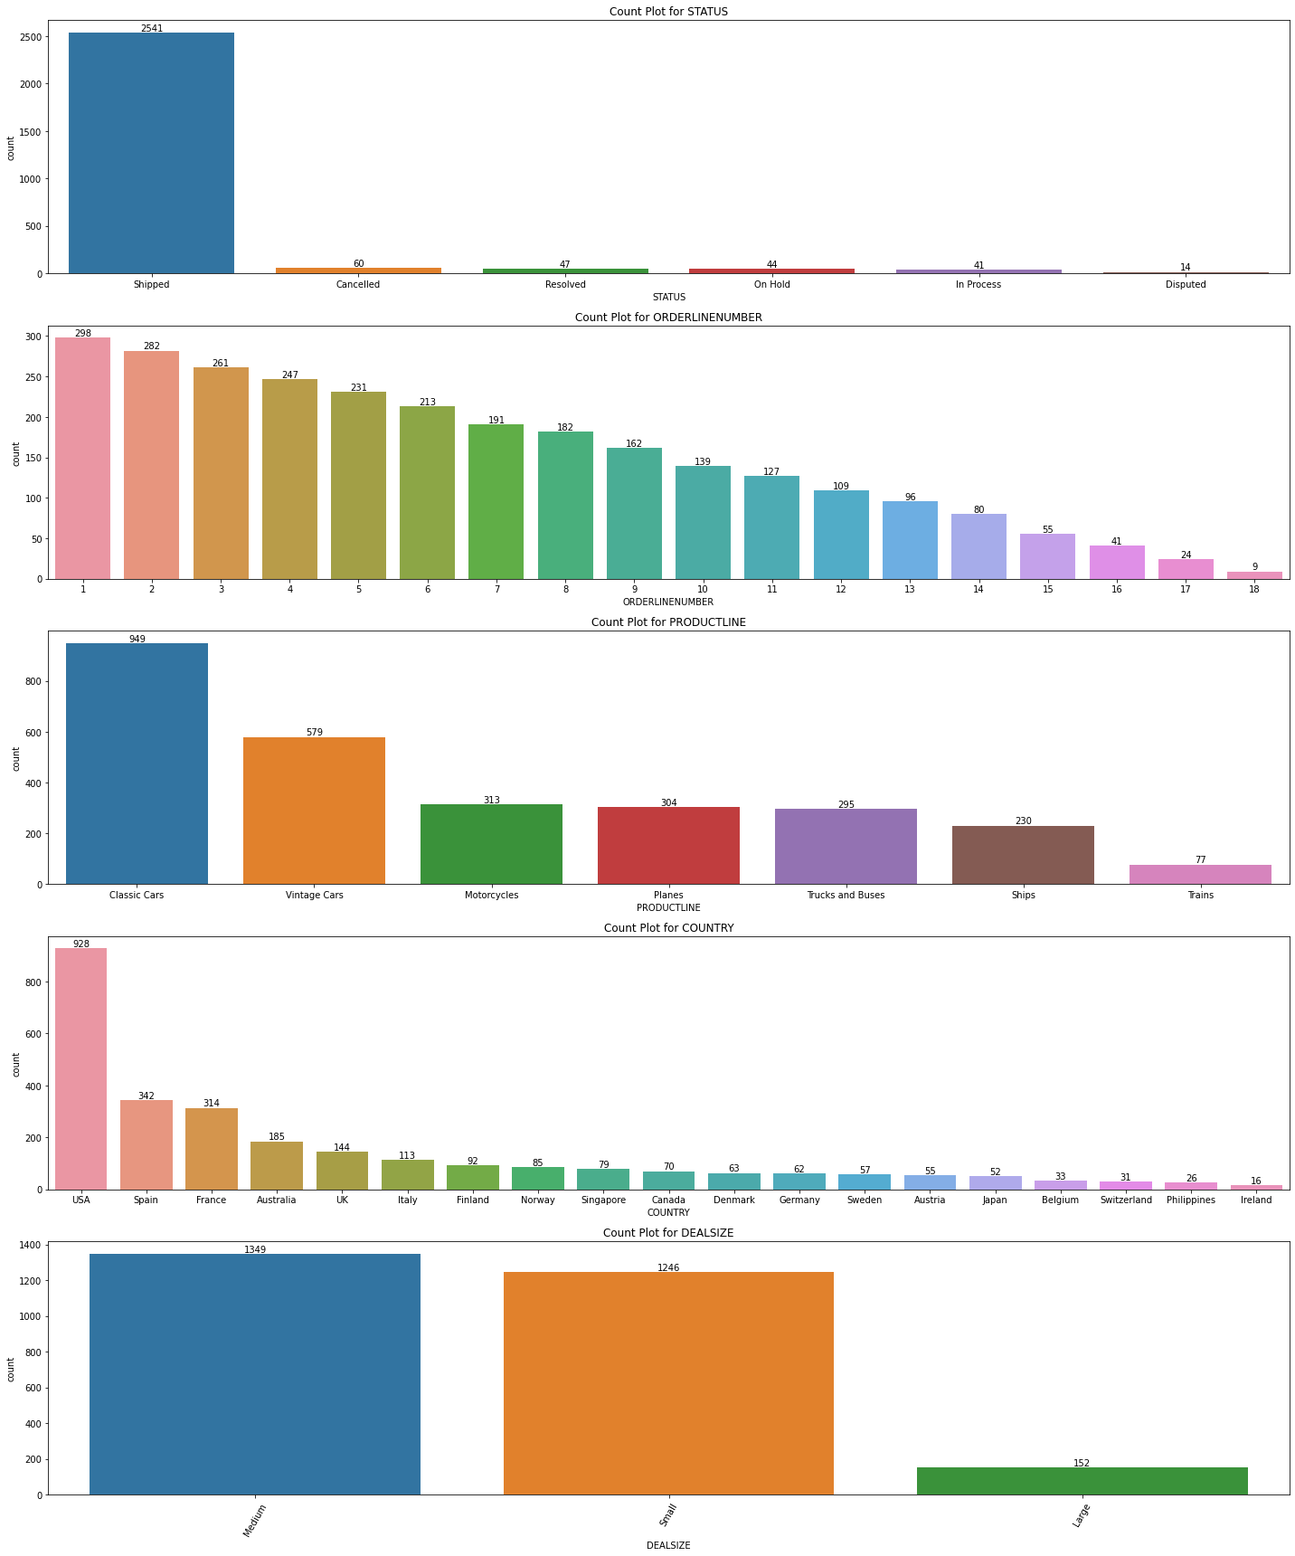
Exploratory data analysis
Univariate Analysis Count Plot

Slide 9
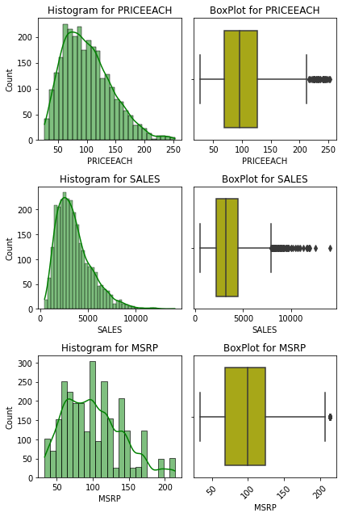
Exploratory data analysis
Univariate Analysis BoxPlot and Histogram
Insights:
1. data is not 100% normally distributed,, but Still I would consider following fields are normally distributed,
because its less skewed
DAYS_SINCE_LASTORDER -0.002983
Whereas these fields are slightly Right skewed:
SALES 1.155940
PRICEEACH 0.697222
MSRP 0.575646
ORDERLINENUMBER 0.575327
QUANTITYORDERED 0.369286
2. "Quantity ordered","PRICEEACH" and "SALES" have significant outliers, whereas "MSRP" has just single outlier

Slide 10
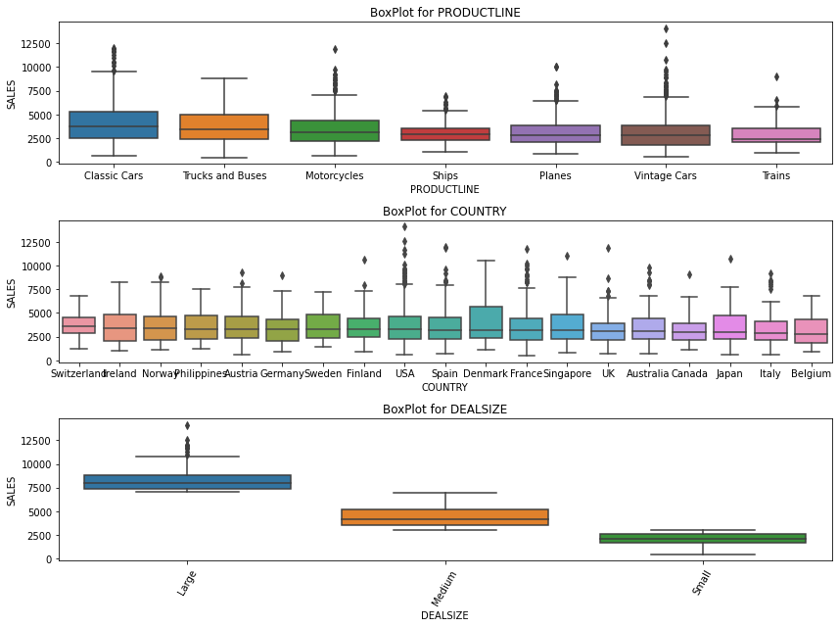
Exploratory data analysis
Bi-variate Analysis BoxPlot
Insights:
We took X axis for Categorical fields and check for it's Sales in Y Axis, and created Box plot for this.
Following are some of insights from this activity:
We see Highest Median in Sales for Disputed Records, Classic car product segment, Switzerland Country and Large DealSize
2. Least median is for Resolved Categories of product , Train ProductLine and Belgium Country

Slide 11
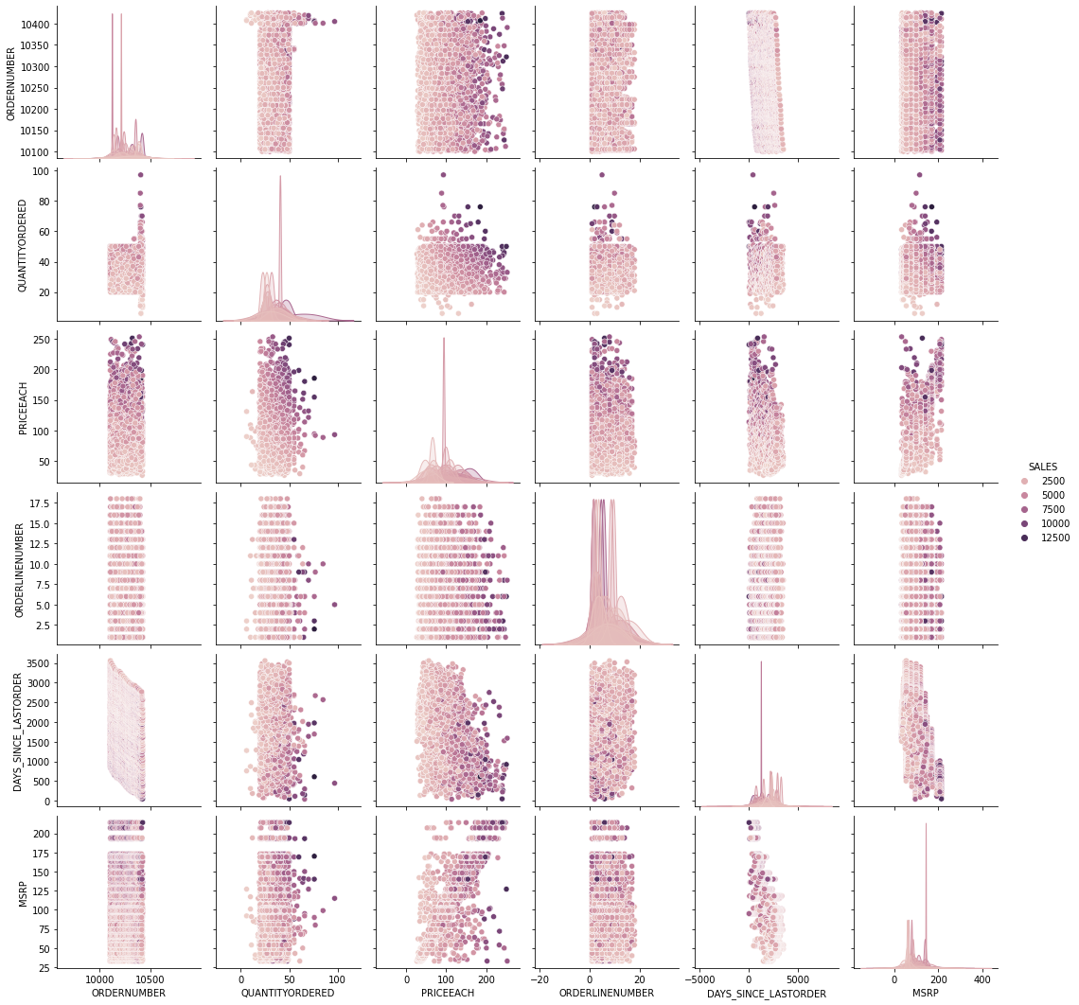
Exploratory data analysis
Multivariate Analysis PairPlot
Insights:
There is no clear separation of the target Column Vote data is not easily separable by Straight Line, which give us a clear picture, we need to perform further analysis for predicting the classes

Slide 12
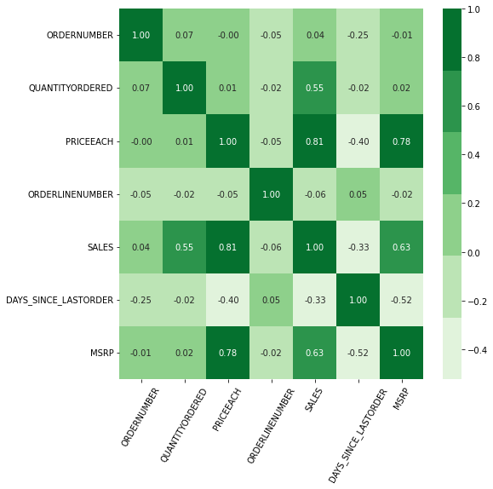
Exploratory data analysis
Multivariate Analysis Heatmap
Insights:
There is Strong co-relation between QuantityOrdered and Sales field with 0.553359 Co-relation point . Also strong co-relation between Sales and PriceEach field with 0.808287 point.
We can ignore orderNumber field from this analysis, as it is of no Use, just check for QunatityOrdered, Priceeach, Sales and MSRP might be useful.

Slide 13
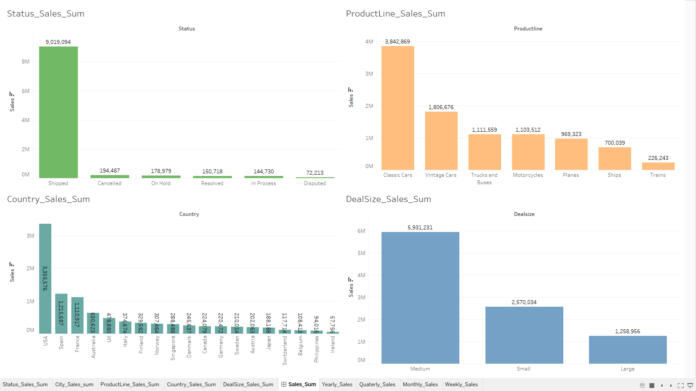
Exploratory data analysis
Sales Counts per Categorical field

Slide 14
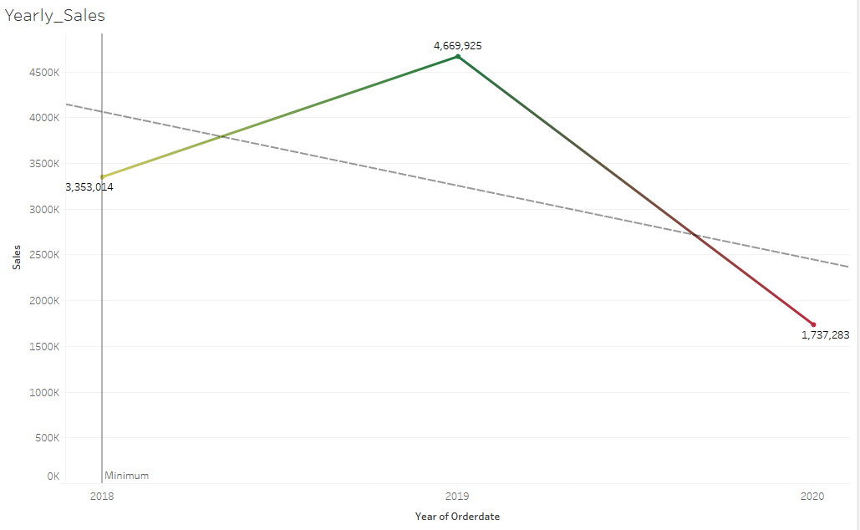
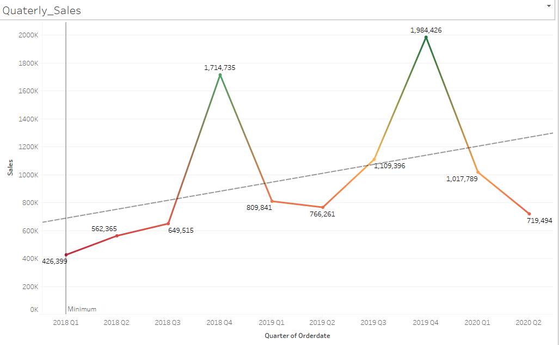
Exploratory data analysis
Timeseries analysis : Yearly/Quarterly trend
Insights:
Trends seems going down, year by year, though we don’t have full data points for last year, so can not decide on this conclusions.
Whereas we can clearly see some growth in Quarterly Sales plot

Slide 15
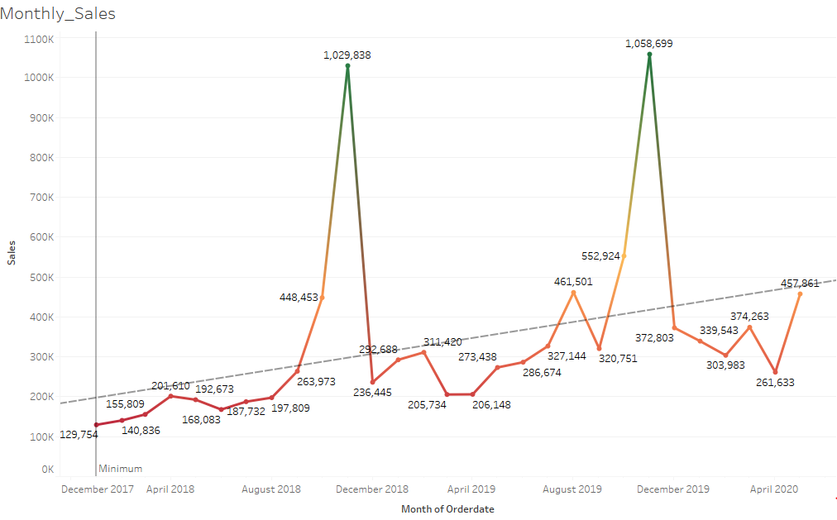
Exploratory data analysis
Timeseries analysis : Monthly trend
Insights:
When we checked for Monthly sales data, upward sales trend is clearly visible . We also see Year end seasonality in the data .
Every year Sales goes up in the last quarter and comes down in first quarter.
Numbers are showing Total sales for that Quarter period.
Reference tableau data analysis can be found over here:
MRS_Project_week_1 | Tableau Public

Slide 16
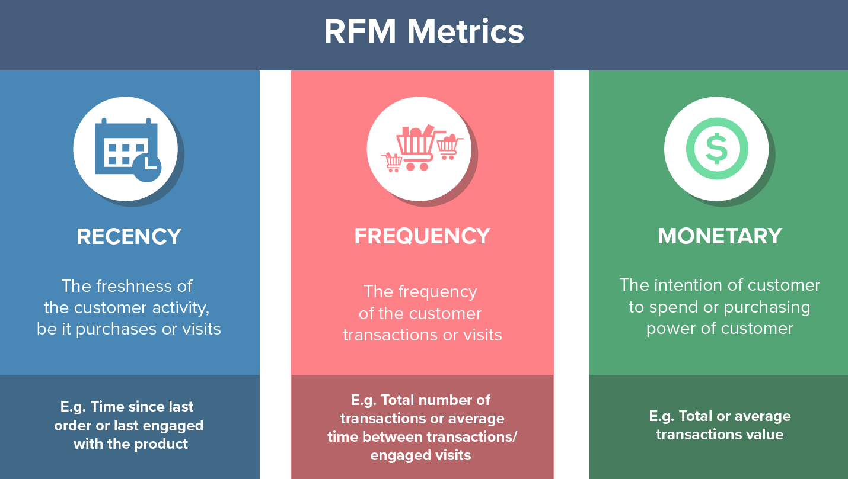
RFM Stand for Recency frequency and Monitory Matrix RFM factors illustrate these facts: Recency: The more recent the purchase, the more responsive the customer is to promotions Frequency: The more frequently the customer buys, the more engaged and satisfied they are Monetary : Total amount spent. monetary value differentiates heavy spenders from low-value purchasers
RFM Analysis
What is RFM

Slide 17

KNIME Analytics Platform is the open source software for creating data science projects. Intuitive, open, and continuously integrating new developments. Main features for KNIME are: 1. Open Source 2. No Coding knowledge required, so easy to use 3. Data science technique knowledge is required, to decide which technique to implement. 4. Node based implementations. 5. Check data in every Node, which makes easy to debug. 6. Developers can write any kind of Node, they want and embed it with KNIME easily. 6. Export, Import, Share, Enjoy.
RFM Analysis
KNIME Tool information

Slide 18
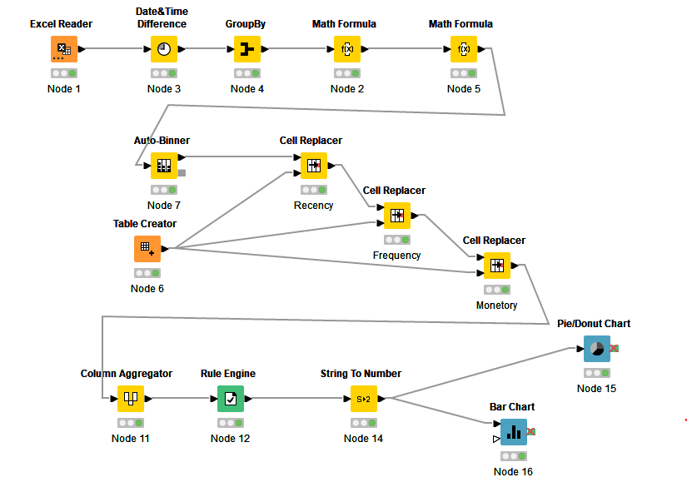
RFM Analysis
Workflow Nodes used and Logic

Slide 19
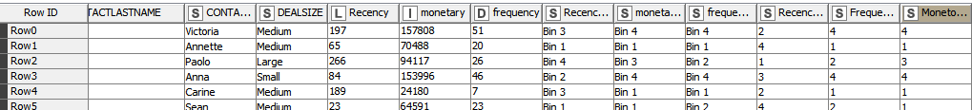
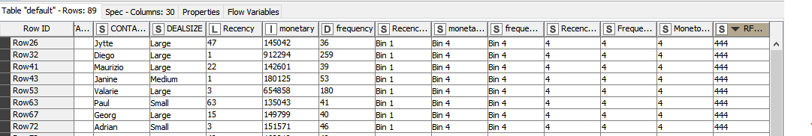
We have used KNIME Analytics tool for our RFM analysis. We have chosen CustomerName as the aggregate column and calculated RFM values for each CustomerName Recency: Was calculated based on [Max(OrderDate) – OrderDate] for each row Frequency: it was calculated by taking COUNT of all ORDERNUMBER , after group by CustomerName Monetary: It was calculated by taking SUM of SALES field after group by CustomerName After calculating RFM values for each row following are the head for the sample data set:
RFM Analysis
Output table Head
I have also grouped Recency , Frequency and Monetary values and formed a single column with RFM Score:

Slide 20
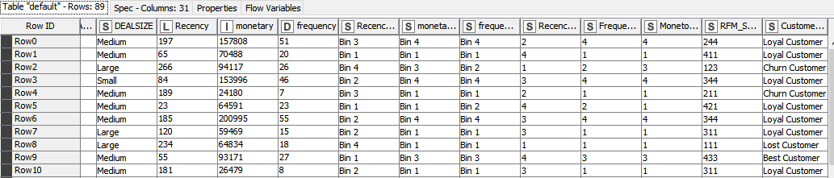
We have also created rules based on RFM_score and created 4 Bins of the customers: Rule formula is as follows: Customers with RFM Score =444, I have considered them as “Best Customers” and we have total of 14 Best customers. Customers with RFM Score 444 and 222, I have considered them as “Loyal customers” and we have total of 48 Loyal customers. Customers with RFM Score 222 and 111, I have considered them as “Churn customers” and we have total of 15 customers can be churned very soon. Customers with RFM Score =111, I have considered them as “Lost Customers” and we have total of 12 Lost customers.
RFM Analysis
Customer Segmentations using RFM

Slide 21
Best Customer’s List:
RFM Analysis
Customer Segmentations using RFM
Lost Customer List
Going to be churn Customer List
CUSTOMERNAME | Rec | monet | freq
Auto Assoc. & Cie. | 234 | 64834 | 18
Bavarian Collectables Imports, Co. | 260 | 34994 | 14
CAF Imports | 440 | 49642 | 13
Cambridge Collectables Co. | 390 | 36164 | 11
Clover Collections, Co. | 259 | 57756 | 16
Daedalus Designs Imports | 466 | 69052 | 20
Double Decker Gift Stores, Ltd | 496 | 36019 | 12
Iberia Gift Imports, Corp. | 239 | 54724 | 15
Online Mini Collectables | 265 | 57198 | 15
Osaka Souveniers Co. | 415 | 67605 | 20
Signal Collectibles Ltd. | 477 | 50219 | 15
West Coast Collectables Co. | 489 | 46085 | 13
CUSTOMERNAME | Rec | Monet | freq
Auto Canal Petit | 55 | 93171 | 27
Danish Wholesale Imports | 47 | 145042 | 36
Diecast Classics Inc. | 2 | 122138 | 31
Euro Shopping Channel | 1 | 912294 | 259
Handji Gifts& Co | 39 | 115499 | 36
L'ordine Souveniers | 22 | 142601 | 39
La Rochelle Gifts | 1 | 180125 | 53
Mini Gifts Distributors Ltd. | 3 | 654858 | 180
Reims Collectables | 63 | 135043 | 41
Salzburg Collectables | 15 | 149799 | 40
Souveniers And Things Co. | 3 | 151571 | 46
The Sharp Gifts Warehouse | 40 | 160010 | 40
Tokyo Collectables, Ltd | 40 | 120563 | 32
UK Collectables, Ltd. | 54 | 118008 | 29
CUSTOMERNAME | Recency | monet | freq
Amica Models & Co. | 266 | 94117 | 26
Atelier graphique | 189 | 24180 | 7
Classic Gift Ideas, Inc | 231 | 67507 | 21
Classic Legends Inc. | 193 | 77795 | 20
Collectable Mini Designs Co. | 461 | 87489 | 25
Diecast Collectables | 402 | 70860 | 18
Herkku Gifts | 272 | 111640 | 29
Marta's Replicas Co. | 232 | 103080 | 27
Microscale Inc. | 211 | 33145 | 10
Norway Gifts By Mail, Co. | 285 | 79224 | 24
Royal Canadian Collectables, Ltd. | 286 | 74635 | 26
Saveley & Henriot, Co. | 457 | 142874 | 41
Super Scale Inc. | 394 | 79472 | 17
Vida Sport, Ltd | 276 | 117714 | 31
Volvo Model Replicas, Co | 195 | 75755 | 19

Slide 22
1. Customers with RFM Score as 444 is marked as best Customers, we need to keep them delighted and give Highest discount possible to make them happy. 2. Customers with RFM Score above 222 are marked as Loyal Customers, Still we don’t see very best RFM values from them. We should always keep them happy as well, in terms of rewards program , so that they stay with the company 3. Customers with RFM values less than 222 are consider as Going to be churn customers, we should try to put them in Gray list, as they have not shown in Customer list for long time, they visited long back for the of their Automobile need, We can keep sending them Email Campaign, as it doesn’t involve any Huge Cost, We can also run any campaign, to know their likings, their current Purchase behavior, if we can do this. And then we can give a fresh start to attract them 4. Customers with RFM values Less than 111 are Lost Customers, Probability, we should not worry about them and stop wasting money on any campaigning them.
Recommendation
RFM Analysis

Slide 23
Thank you
Amit Jain

